Slide 1
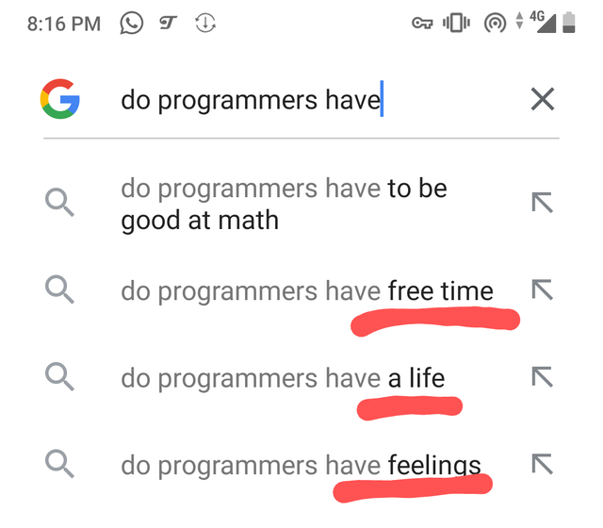

Slide 2
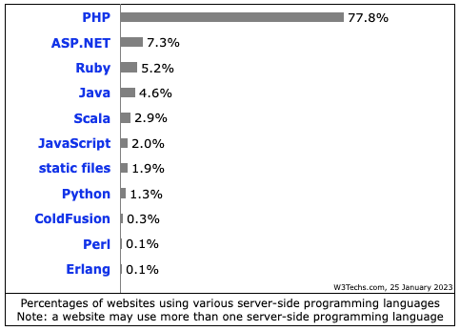
Usage statistics. (2023). Web3Techs, Retrieved January 10, 2023, from https://w3techs.com/technologies/overview/programming_language

Slide 3

1. Creating Output
2. Variables
3. If Statements
4. Loops
5. Functions

Slide 4


Slide 5
1. Control Structures

Slide 6
If Statements Comparisons
Comparison and Logical operators are used to test for true or false:
Equal To | ==
Less Than | <
Greater Than | >
Less Than or Equal To | <=
Greater Than or Equal To | >=
Not Equal To | !=
PHP 5 Operators. (n.d.). W3Schools, Retrieved April 10, 2016, from https://www.w3schools.com/php/php_operators.asp

Slide 7
If Statements Equal Signs
When comparing there are small differences that make a big difference:
= | Assigning
= = | Comparing (converted to same types)
= = = | Comparing (no conversion)
! = | Not Equal To (converted to same data types)
! = = | Not Equal To (no conversion)

Slide 8
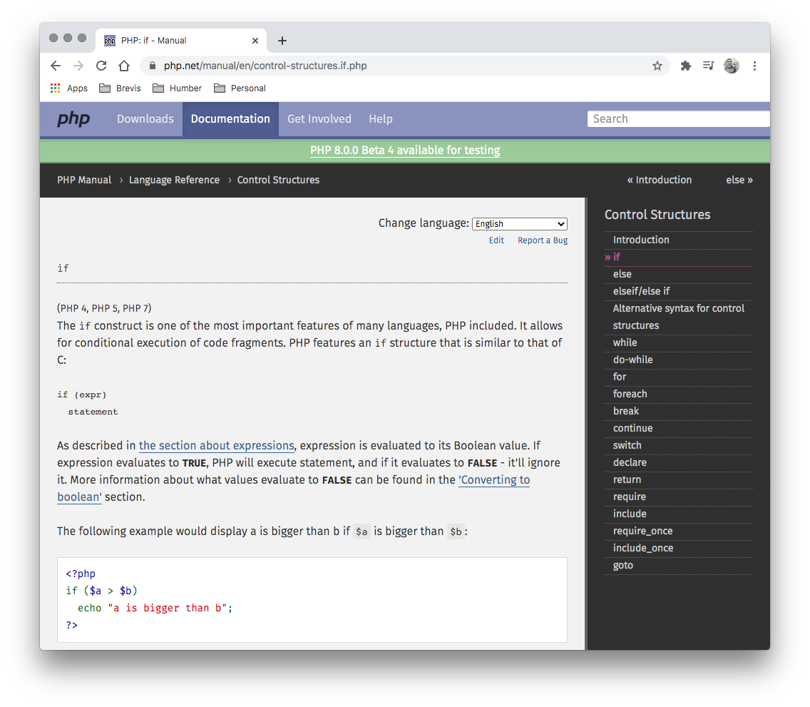
If Statements
PHP uses if statements to make decisions:
<?php $hour = date('G'); if( $hour < 12 ) { $greeting = "Good morning!"; } ?>

Slide 9
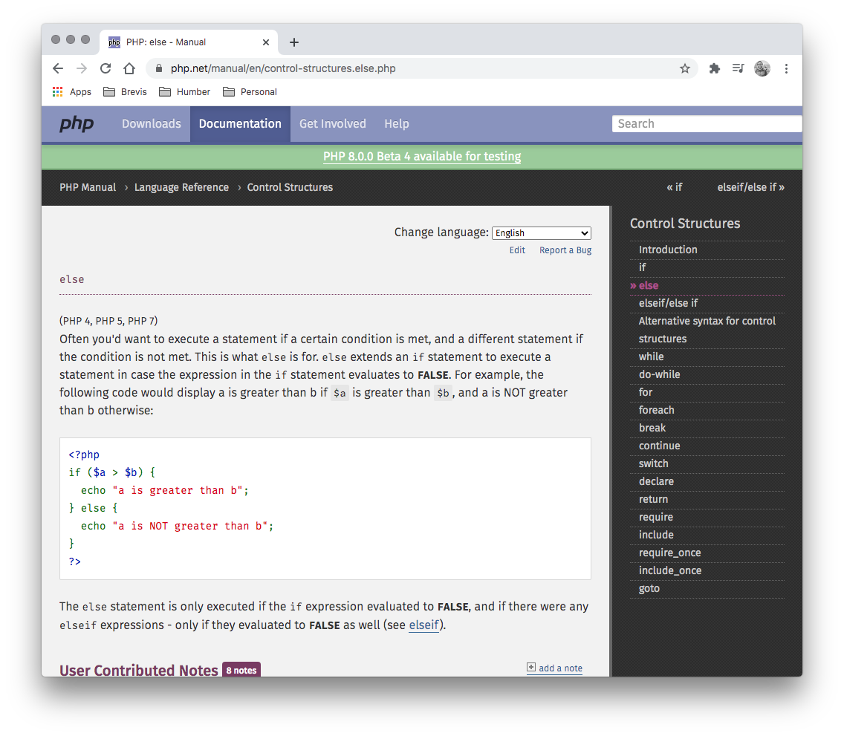
Else Statements
An else statement can be added to add a second option to a decision:
<?php $hour = date('G'); if( $hour < 12 ) { $greeting = "Good morning!"; } else { $greeting = "Good afternoon!"; } ?>

Slide 10
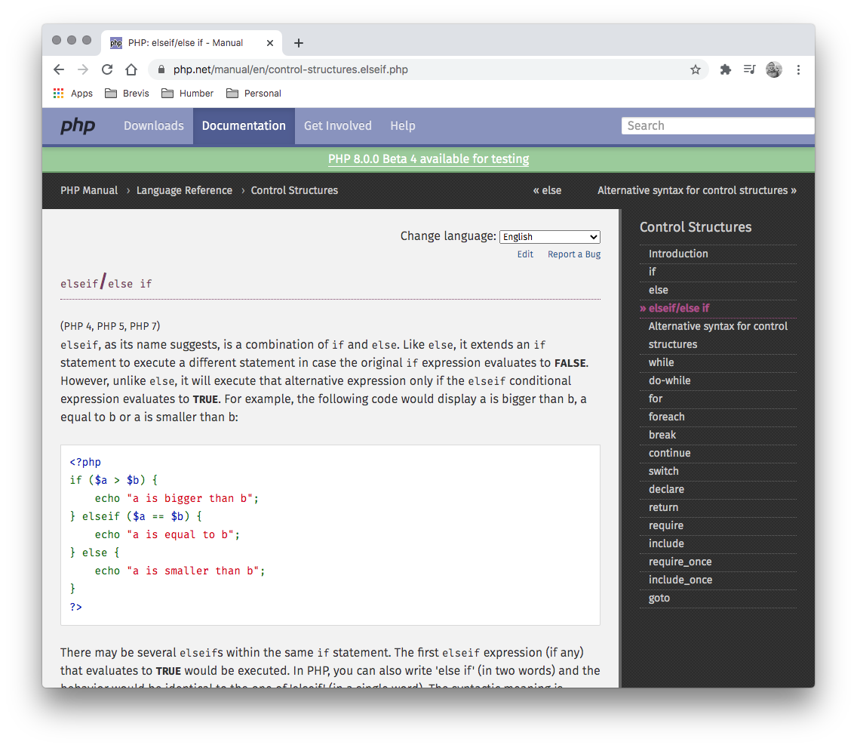
Elseif Statements
An elseif statement can be added to add a second option to a decision with it’s own criteria:
<?php $hour = date('G'); if( $hour < 12 ) { $greeting = "Good morning!"; } elseif( $hour < 19 ) { $greeting = "Good afternoon!"; } ?>

Slide 11
If Statements Equal Signs
When a condition is compared the result is always a true or false:
False | True
0 (zero) | Everything Else
null
"" (blank)
false
undefined

Slide 12
Control Structures
Create an HTML/JavaScript document that displays the proper greeting:
Monday - Do you have a case of the Mondays?
Friday Afternoon - It’s almost the weekend!
Before Noon - Have a good morning!
After Noon - Have a good day!
Weekend - It’s the weekend!!!
Start with this code to get the current date:
$hour = date('G'); $day = date('w');

Slide 13
2. Using Switches

Slide 14
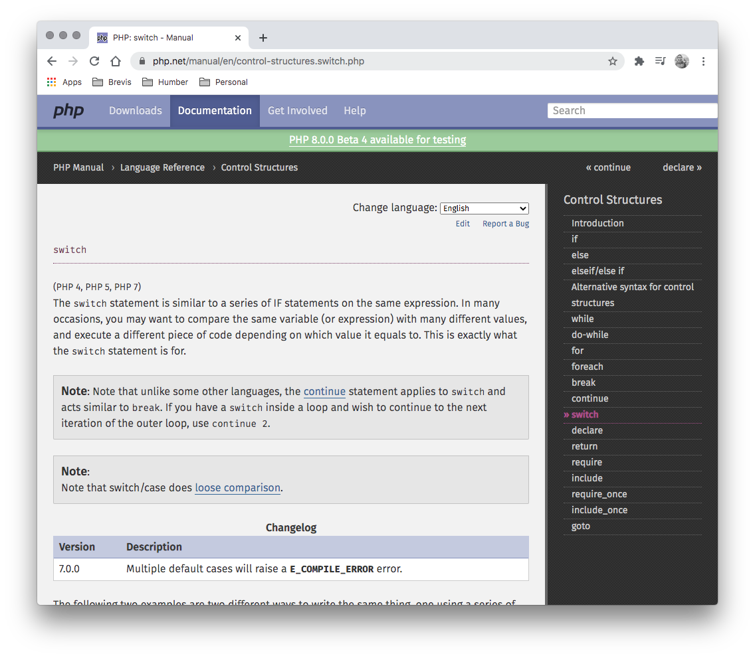
Switch Statements
A PHP switch is a very specific type of if statement. It can be used when the decision is based on one variable having a variety of values:
switch ($day)
{
case "Monday":
echo "Sounds like someone...";
break;
case "Friday":
echo "TFIG!";
break;
default:
echo "Have a great day!";
break;
}

Slide 15


Slide 16
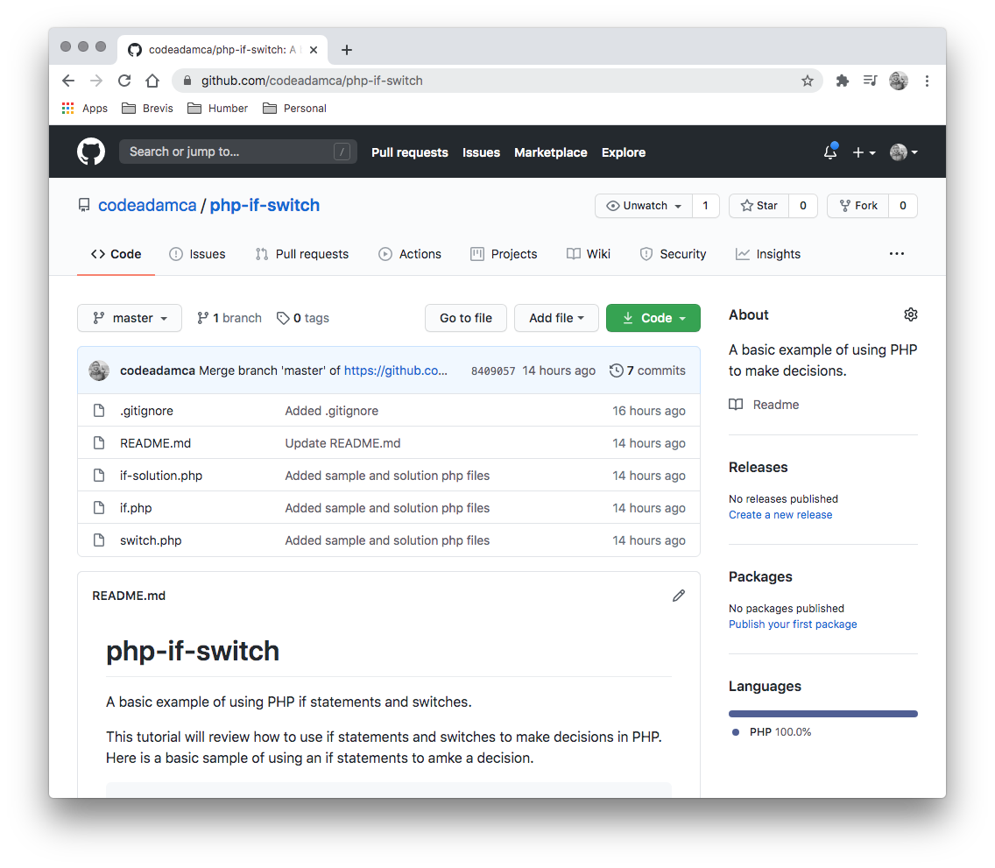
PHP If/Switch Exercise
Follow the output exercise on GitHub:
https://github.com/codeadamca/php-if-switch

Slide 17
3. PHP Exercise 1

Slide 18
Goals this Week
1. Understand how to use if statements 2. Start working on the second PHP exercise

